Slide 1
英语多模态词汇教学探究
—故事情景教学和音视频模仿教学
主讲：欧国丽

Slide 2
词汇是语言学习的重要方面之一，英语词汇教学更是英语教学中必不可少的环节。多模态教学打破了传统的教学模式，其运用听觉、视觉、触觉等多种感觉，通过语言、声音、图像、动作等多种手段和符号提高学生学习词汇的效率，增长学习英语的热情，也会提高教学质量。

Slide 3
1
词汇教学内容多模态化
01
探究
2
词汇教学手段多模态化
3
词汇教学评价多模态化
词汇多模态教学的感悟
4

Slide 4
1.词汇教学内容多模态化
教学内容多模态化使教学内容具有实用性、趣味性和多样性。
例如，我在讲授人教版初中英语七年级“Good Moring!”一课时，可以播放一段外国人相互问候的歌曲视频。

Slide 5
这样更容易营造出有利于学生对本课词汇
理解、掌握以及运用的真实语境，并且让
学生有机会接触规范英语，更加有利于知
识的吸收和构建。

Slide 6
2.词汇教学手段多模态化
多模态词汇教学可以利用图画、视频、音响、网络等多种手段来辅助教学，对传统教师授课进行有效的补充。同时，学生可以通过多感官共同参与学习来提高词汇综合运用能力，进而促进英语综合运用能力的形成。

Slide 7
Unit 2
①图片模态
I think that mooncakes are delicious!
SectionA 3a-3c

Slide 9
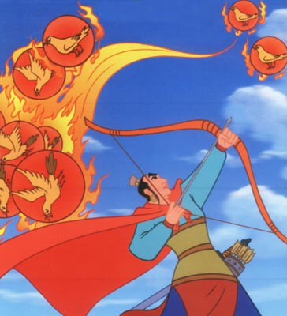
Do you know the story?
New words
The story of Chang’e.
It’s a traditional folk story.
传统的
民间的；民俗的
Chang’e is a goddess.
女神

Slide 10
New words
A bad man called Pang Meng
stole 偷
He tried to steal the medicine, whoever took this could live forever.
无论谁

Slide 11
The Mid-Autumn Festival.

Slide 12
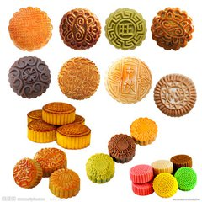
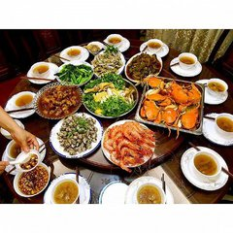
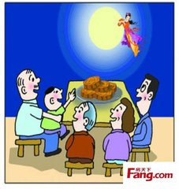
New words
How do people celebrate this festival?
eat mooncakes
dessert 甜食；甜点
欣赏；仰慕
admire the moon
in the garden
花园；
园子
laid 摆开；放置
lay out some delicious food on the table and have a big dinner with families

Slide 13
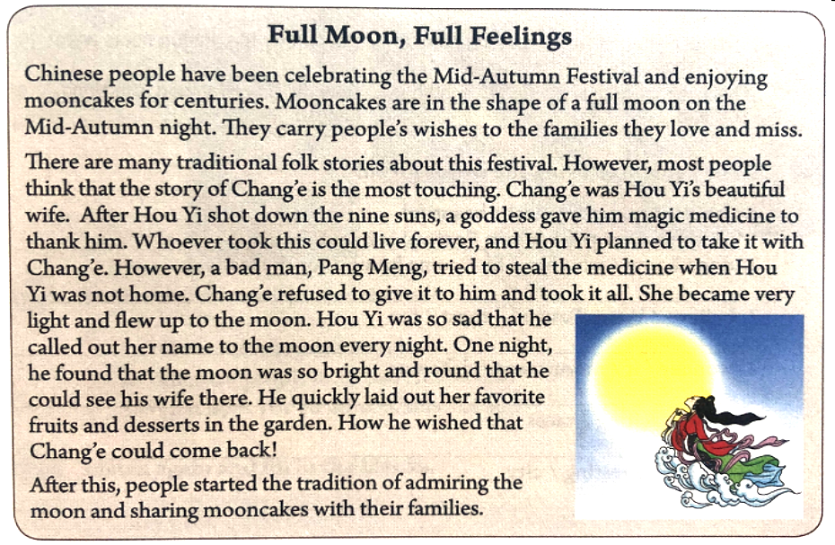

Slide 14
图片模态以图片建构视觉情境，在扩大学生的视觉接触极限中，有效学习新词的音、义、形。

Slide 15
②音视频模态

Slide 16
借助音视频，建构立体词汇学习场景，高效学习生词的音、义、形。

Slide 17
③语篇模态:
看英文短文说核心单词中文（eg.disaster-灾难）
I was born in Taipei City. In Taipei, we have natural disasters, such as typhoons and floods. We have several typhoons during the typhoon season from June until October. I remember that one summer vacation while I was studying in high school, a typhoon named Andrew came to our city. It still stays in my mind. Andrew brought rain, really heavy rain. The river near my house overflowed(溢出), and water began to come into my house. My parents, younger brother, sister and I moved out the most important things to the safe place. My parents and I moved the fridge up on the dining table. There was more and more water in our house. To keep safe, we had to move up to my cousin's house. His house was on the second floor. After the rain stopped, we went back home and cleaned up everything. There was much mud(淤泥) in our house, so it was really difficult to clean it up. But luckily, everyone in our home was all right.

Slide 18
在语篇语境中学习词汇，培养词汇语篇思维意识。

Slide 19
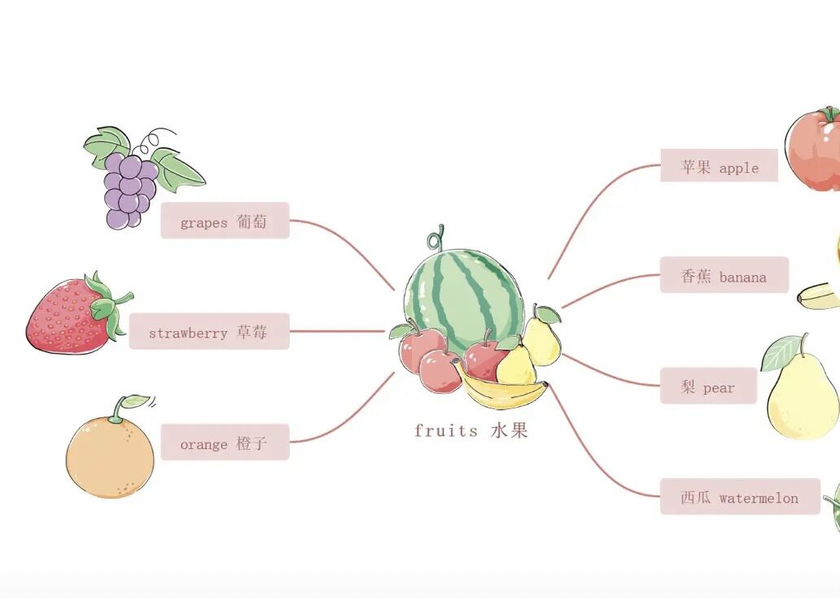
④思维导图模态

Slide 21
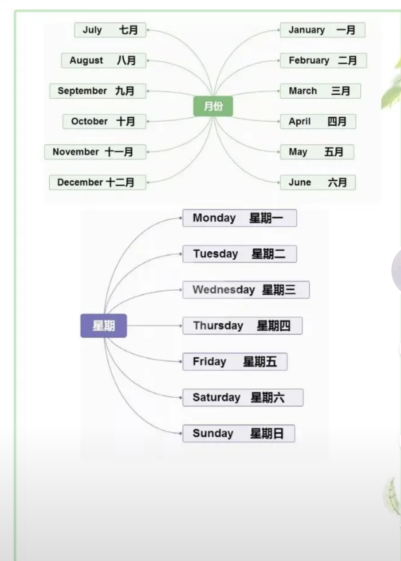

Slide 22
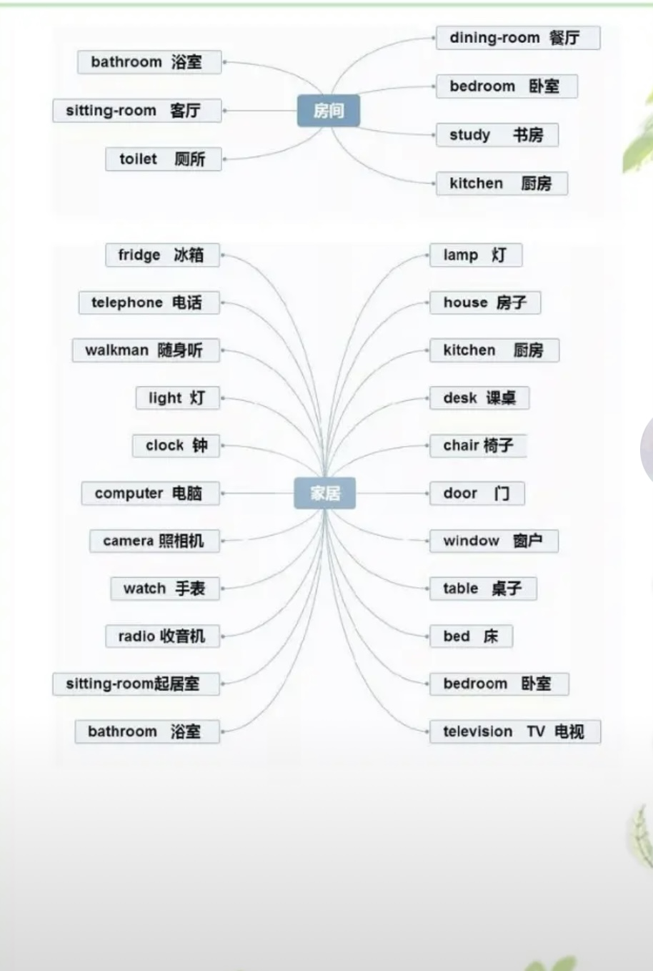

Slide 23
思维导图的方法让学生系统而又有条理的去背诵英语单词。好的方法会让学生背单词事半功倍，不容易忘记。

Slide 24
3.词汇教学评价多模态化
教学不只是教学内容、教学方法和学习方法的多元转变，还包含了学习评价的过程。
①
依托小组合作，推进过程性评价
②
依托当堂检测，推进诊断性评价
③
培养反思习惯，推进发展性评价

Slide 26
Exercises

Slide 27
加 2 分
B
On the Mid-Autumn night, we often ___ out
some fruit and mooncakes in the garden
and admire the moon .
A. laid
B. lay
C. lie
D. lies

Slide 28
白加 1 分

Slide 29
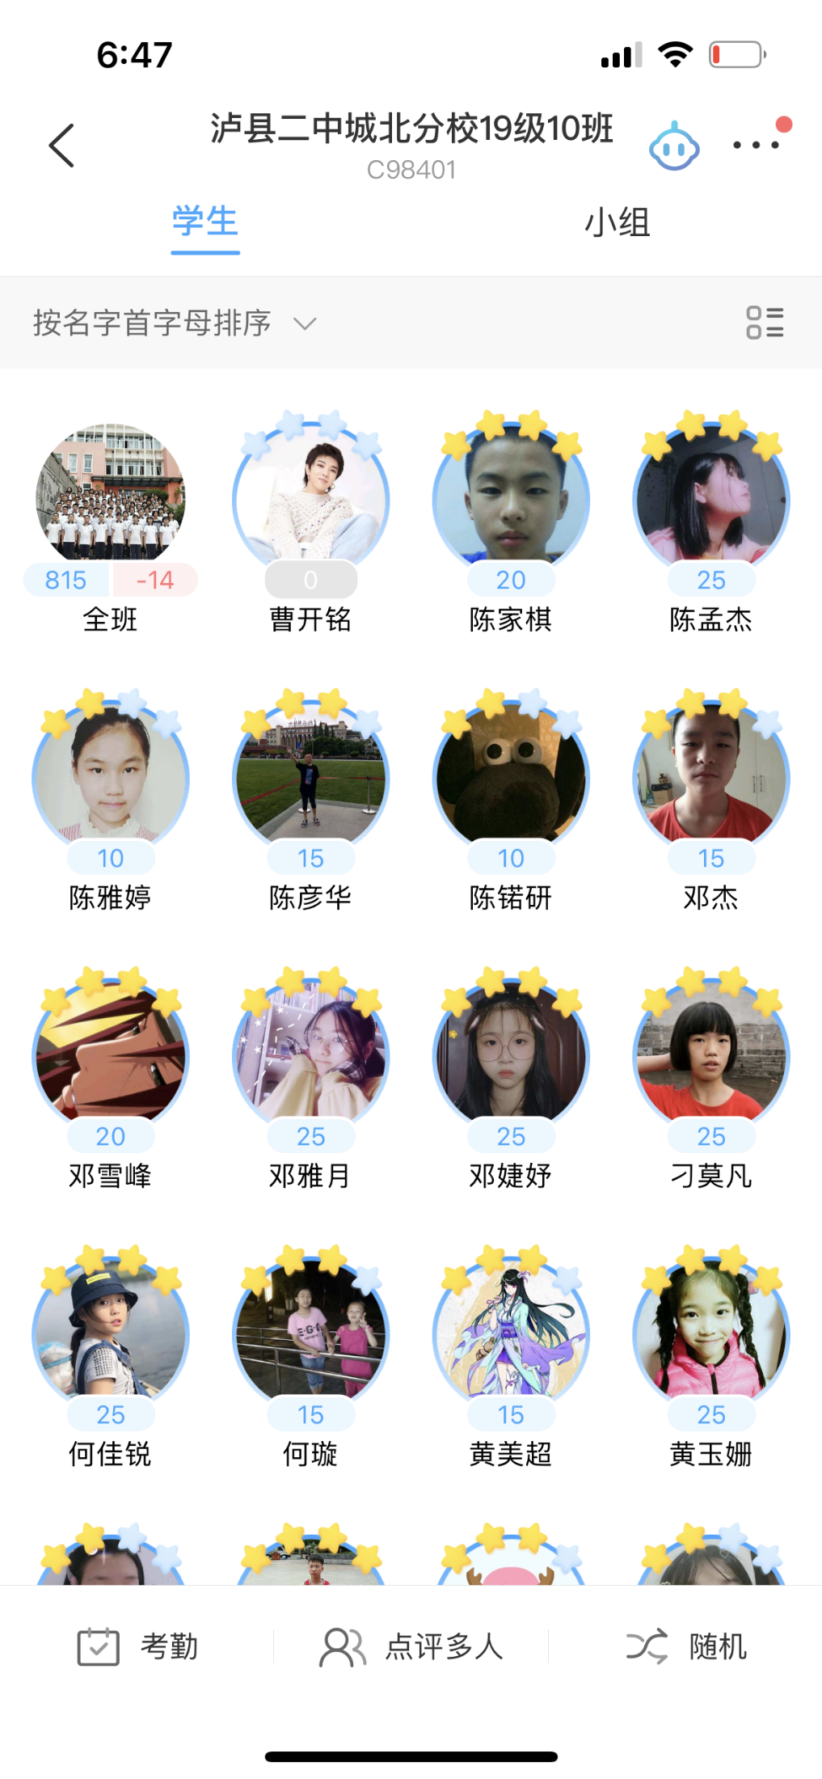
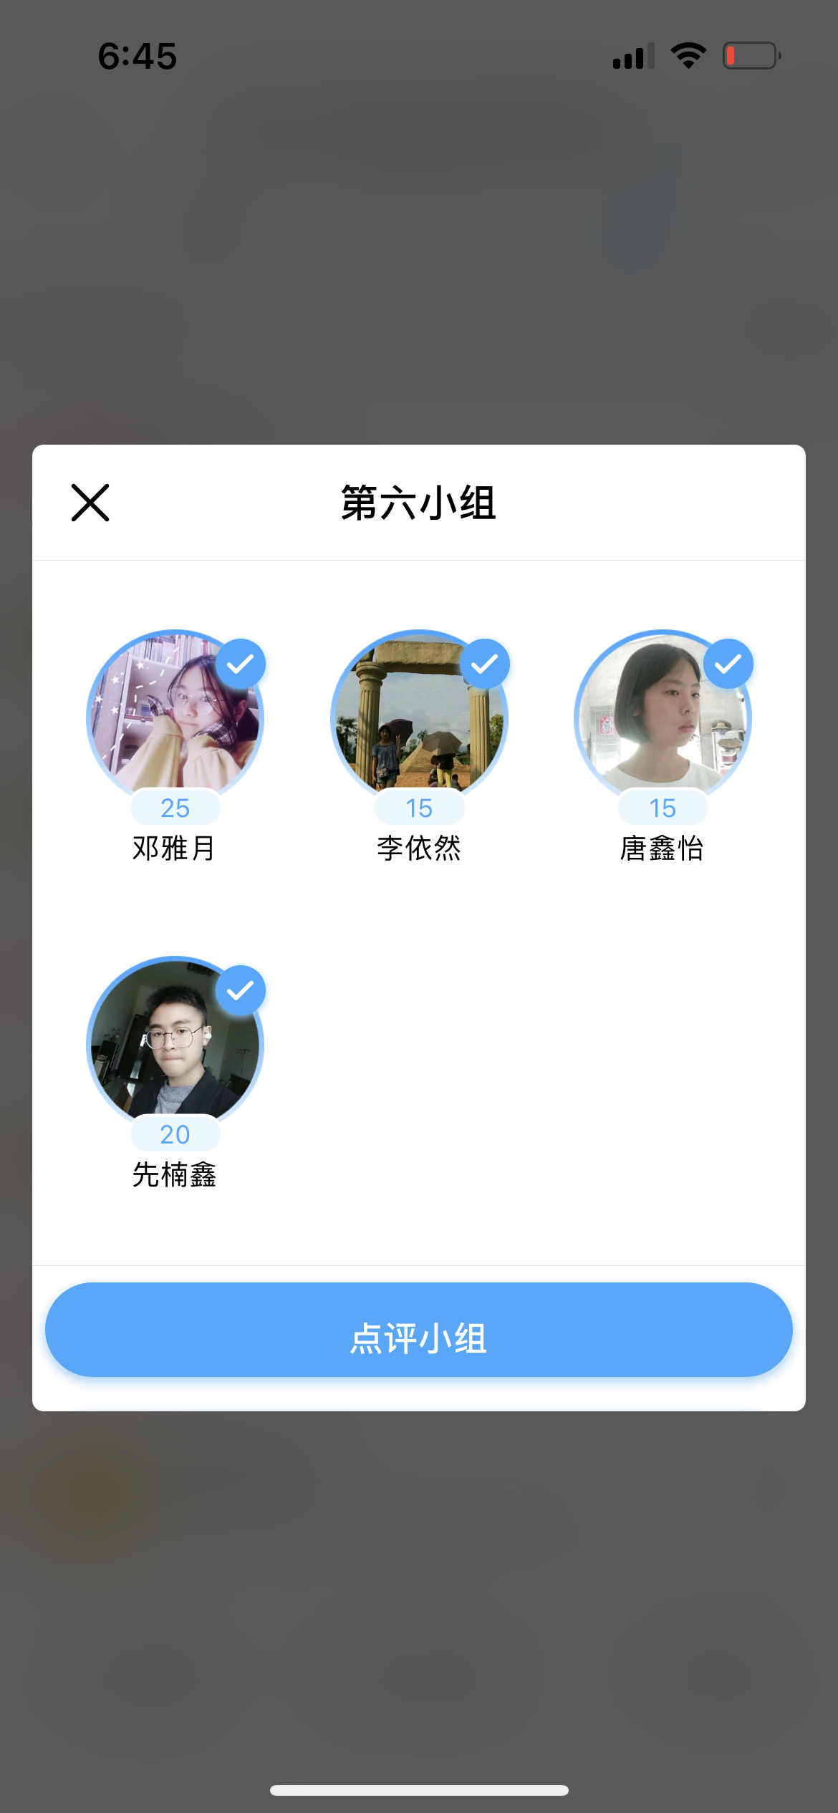

Slide 30
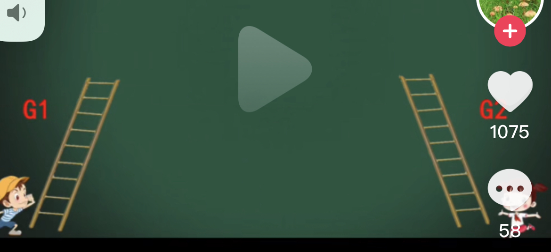
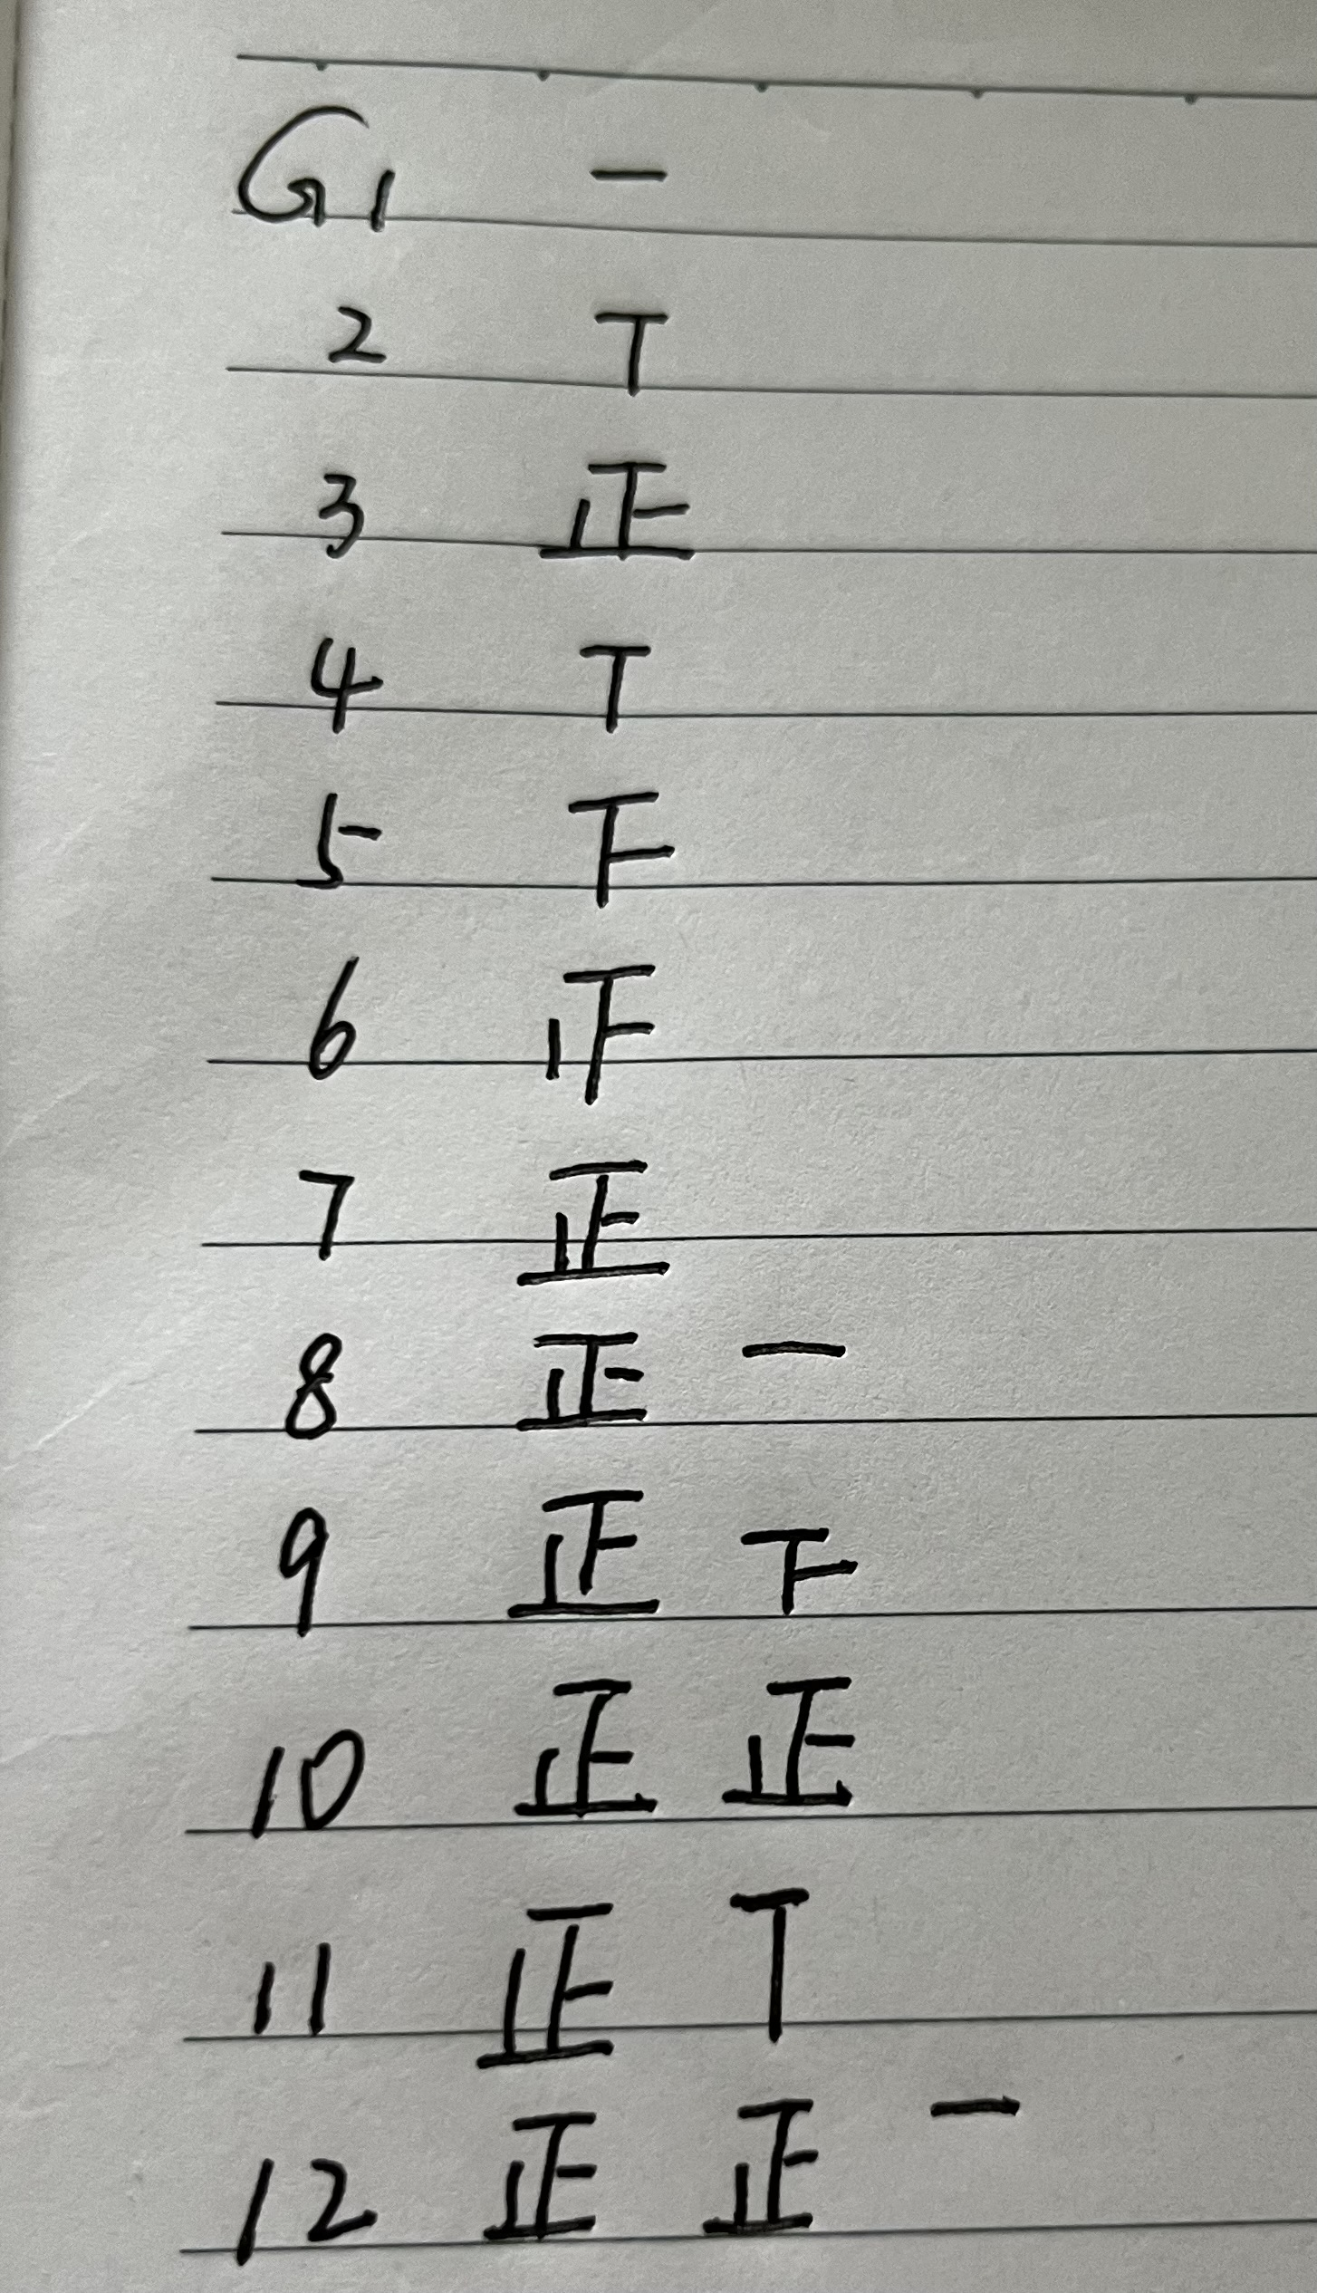

Slide 31
通过学生在学习过程中的表现去判断每位学生的学习质量和水平，符合人的多元智能的实际，有利于激发学生的学习动力和自信心。

Slide 32
4.词汇多模态教学的感悟
英语多模态的教学方法不但使课堂变得生动有趣，提高了学生的英语学习兴趣和学习积极性而且使学生通过多感官共同参与学习来提高词汇综合运用能力，进而促进英语综合运用能力的形成。
英语多模态教学是教学改革的新方向，让我们在实践中不断摸索前行。

Slide 33
Thanks for listening!
Bye-bye!

