Slide 1
Unit 6 I’d like some fried fish with vegetables.

Slide 8
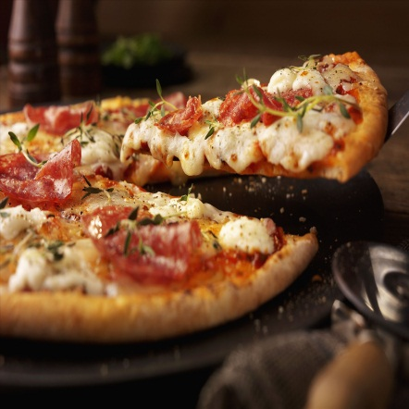
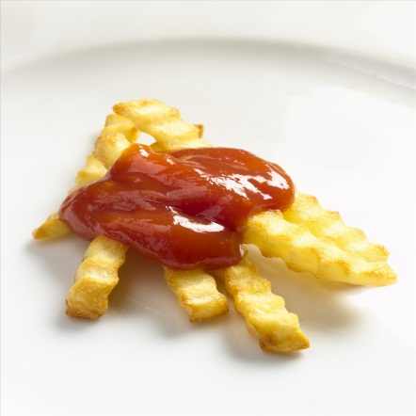
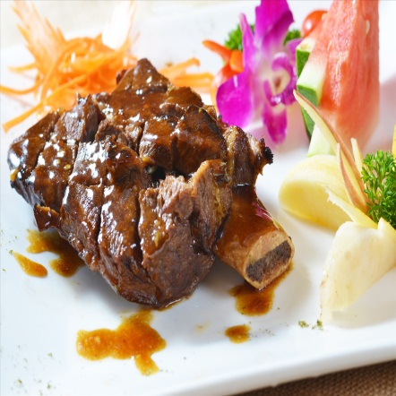
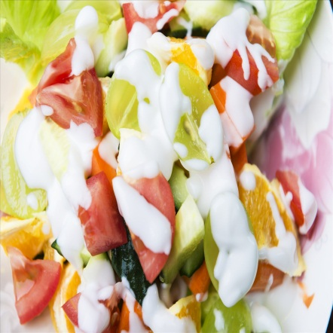
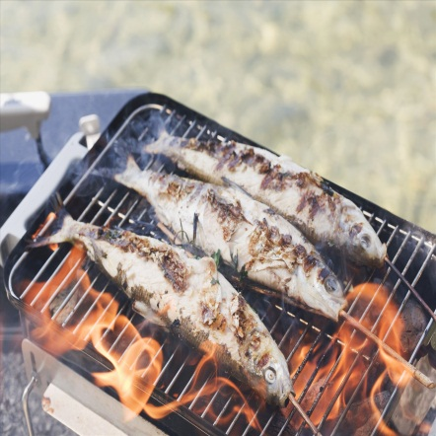
Activity 1
Look and match.
Lead in
lemon tea
pizza
steak
1
4
tasty hot
juicy sour
fresh crispy
2
6
French fries
3
5
salad
fried fish

Slide 9
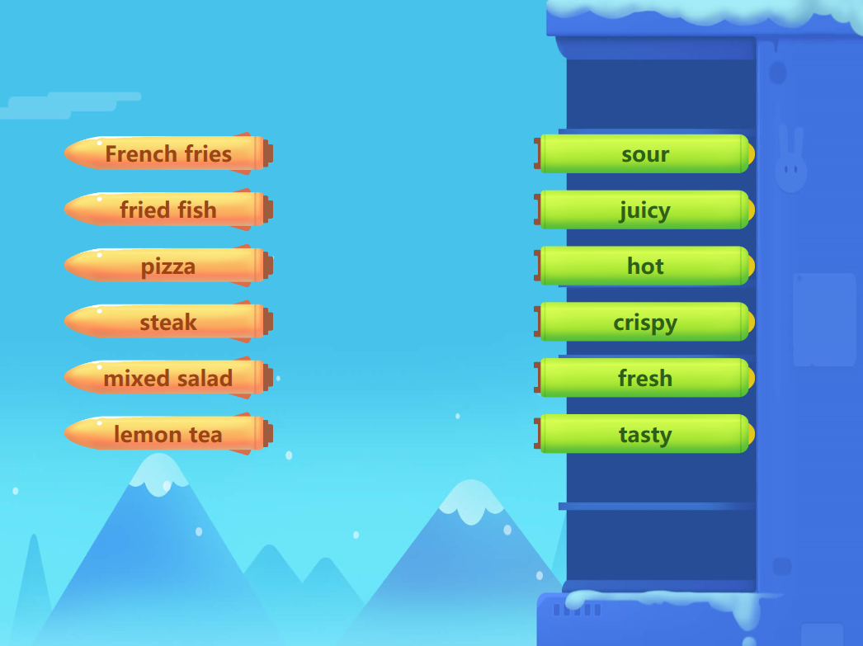

Slide 10
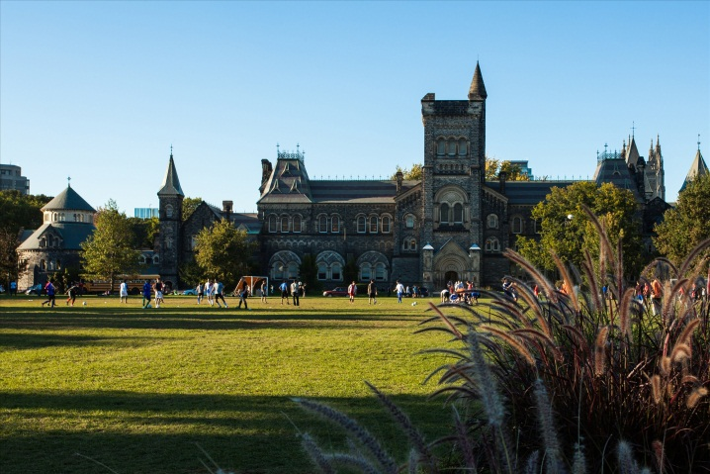
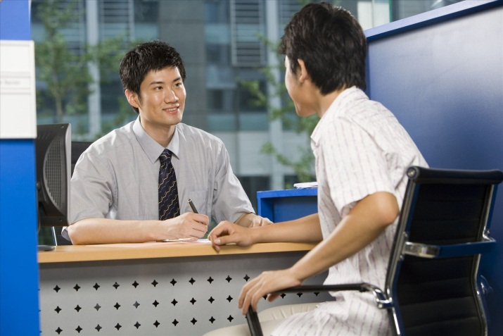
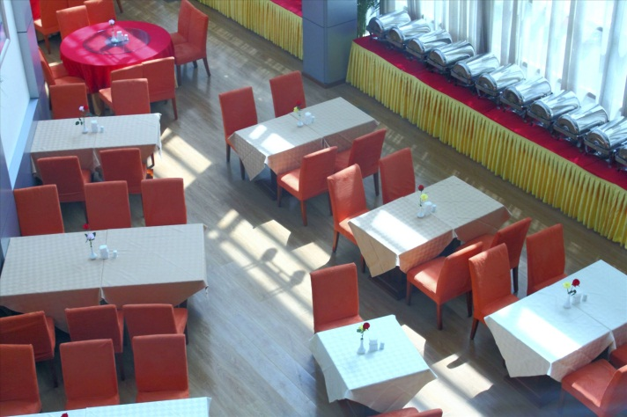
Activity 2
Listen and circle.
Listening and speaking
A
C
B

Slide 11
Activity 3
Listen and judge.
Listening and speaking
Emma has
_______ to start.
A. soup
B. salad
C. cake
2. Emma orders beef steak for _______.
A. starter
B. main course
C. dessert
3. How would Emma like her steak done?
A. medium
B. well-done
C. medium well-done
4. Emma thinks whiskey is _______.
A. better
B. worse
C. stronger

Slide 12
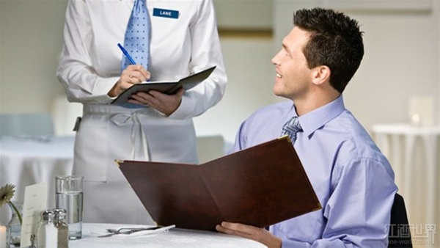
Activity 4
Listen and complete.
Listening and speaking
1. I’d like to ______ ______ a mixed salad.
2. The steak tastes more ________ with it.
3. I’ll be back _____ ____ _____ in a moment.
start
with
delicious
with
your
order

Slide 13
Listening and speaking
Waiter: Excuse me, can I take your order now?
Emma: Yes, I’d like to start with a mixed salad.
Waiter: What would you like to have for the
main course?
Emma: I’d like a beef steak.
Waiter: How would you like your steak done?
Emma: Medium.
Waiter: Anything to drink? Would you like some
red wine? The steak tastes more
delicious with it.
Emma: I’d like something stronger. I think I’ll
have some whiskey.
Waiter: Okay, would you like some ice cubes?
Emma: Yes, please.
Waiter: All right, I’ll be back with your order in a
moment.

Slide 14
Activity 5
Listen and repeat.
Listening and speaking
Waiter: Excuse me, can I take your order now?
Emma: Yes, I’d like to start with mushroom soup.
Waiter: What would you like to have for the main course?
Emma: I’d like some fried fish with vegetables.
Waiter: With tomatoes or with potatoes?
Emma: Lettuce is fine.
Waiter: Anything to drink? Would you like to have some
wine? The fried fish tastes more delicious with it.
Emma: I prefer a soft drink.
Waiter: How about a cup of ice tea with lemon?
Emma: I’d like something warmer. A cup of black tea,
please.
Waiter: All right. I’ll be back with your order in a moment.

Slide 15
Listening and speaking
服务员: 打扰一下，您现在需要点餐了吗？
Emma: 是的，先来一个蘑菇汤。
服务员: 主菜您想吃点什么？
Emma: 我想来一份炸鱼和蔬菜。
服务员: 配餐要西红柿还是土豆？
Emma: 生菜就好。
服务员: 要喝点什么吗？要不要来点红酒？炸鱼配着红酒味
道会更好。
Emma: 我更喜欢软饮料。
服务员: 柠檬冰茶怎么样？
Emma: 我喜欢热一点的。请给我一杯红茶吧。
服务员: 好的。稍后我就给您上菜。

Slide 16
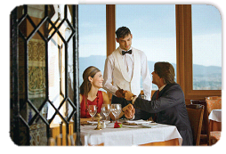
Activity 6
Practice and act.
Listening and speaking
A: Can I take your order now?/ What
would you like to start with?
B: I’d like….
A: What would you like to have for
the main course?
B: I’d like….
A: Anything to drink?
B: I’d like….
 | Starter | Main course | drinks
Customer 1 | Corn soup | Fried chicken | Coco cola
Customer 2 | Green salad | Pork hamburger | Orange juice
Customer 3 | Seafood soup | Beef steak | Black coffee

