Slide 2
Unit6
Tell me when the pain started

Slide 3
1
stomachache胃痛
2
toothache牙痛
3
fever发烧
4
cough咳嗽
5
headache头疼
6
back pain背疼

Slide 4
Act and guess

Slide 5
Listening and speaking
2. Listen and complete.
Appointment Report Card
Patient Name
Tom
Symptoms (症状)
a bad back pain
a headache, ________________, hurting eyes
Possible causes
playing computer games
Appointment time
_____________________________
at 3 this afternoon

Slide 6
Watch a show
one act nurse, one act patient(Tom)

Slide 7
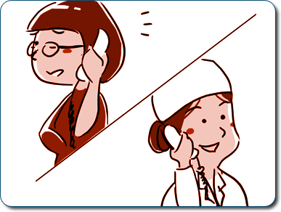
Listening and speaking
3. Listen and underline.
Nurse:
Betty:
Nurse:
Betty:
Nurse:
Betty:
Good morning, Dr. King’s office.
Good morning, my name is Betty and I would like to make an appointment.
What’s wrong with you?
I have a runny nose. And I cough all the time.
How long have you felt this way?
For about one day.

Slide 8
Listening and speaking
3. Listen and underline.
Nurse:
Betty:
Nurse:
Betty:
Nurse:
Betty:
Nurse:
Betty:
I see. Do you feel cold?
Yes, I feel very cold. I think I have a fever.
Well, Dr. King is free at 2 this afternoon. Will this be OK for you?
Can you make it earlier?
Well, let me see. What about 11 this morning?
11 is fine.
OK, see you then.
Thank you very much.

Slide 9
Listening and speaking
Role play
Doctor:
Patient:
Doctor:
Patient: Doctor:
Patient:
What’s wrong with you?
I have a headache and a sore throat.
How long have you felt this way?
For a week.
I see. Well, you have caught a cold. Take this medicine three times a day. You should drink more water and have a good rest.
Thank you.

Slide 10
Listening and speaking
4. Talk and act.
1.
Bob:
Doctor:
a terrible toothache, a week
not serious, brush teeth, eat less sugar, take the medicine twice a day
2.
Eva:
Doctor:
cough, feel cold, one day
fever, drink more water, stay in bed warm, take
the medicine three times a day

Slide 11
Summary
Listening and speaking
Key words:
Stomachache
toothache
fever
Cough
headache
backpain
Key phrases:
What’s wrong with you?
What’s the matter with you?
What’s your trouble?
He/she has a …
I have a runny nose.
And I Cough all the time.
How long have you felt this way?
For about one day.

Slide 12
Homework
1.preview the page 96-97
2.write a dialogue same as activity 7.

Slide 13
THANKS！
Unit6

