Slide 1
Unit 5 What’s your hobby?
Reading and writing
官海燕
泸州市电子机械学校

Slide 2
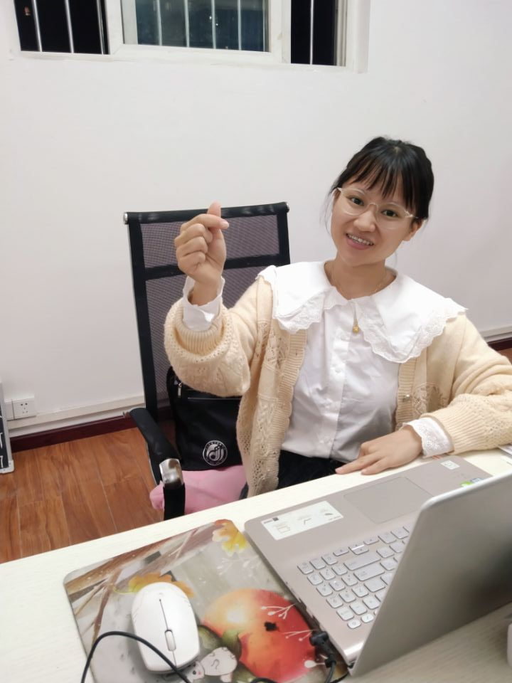
Sunny

Slide 3

Welcome
to my class!

Slide 4

Hello，
everybody！

Slide 5
s unny
name’s
My

Slide 6
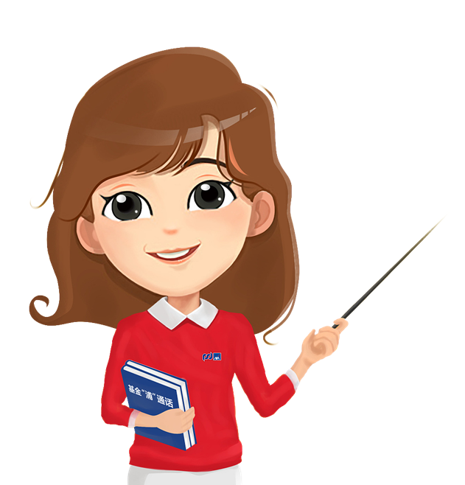
friendly

Slide 7
friendly

Slide 8
friendly

Slide 9
friendly

Slide 10
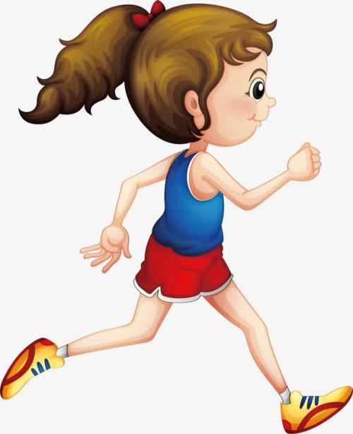
I like
relaxing

Slide 11
I like
relaxing

Slide 12
I like
relaxing

Slide 13
I like
relaxing

Slide 14
I like
relaxing

Slide 15
I like
relaxing

Slide 16
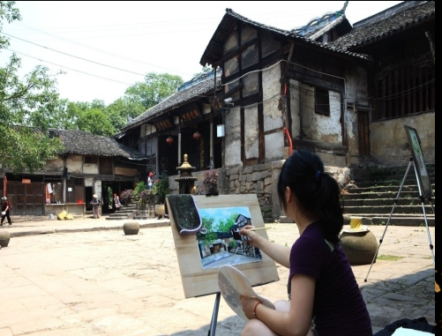
I also like
interesting

Slide 17
I also like
intersting

Slide 18
I also like
intersting

Slide 19
I also like
intersting

Slide 20
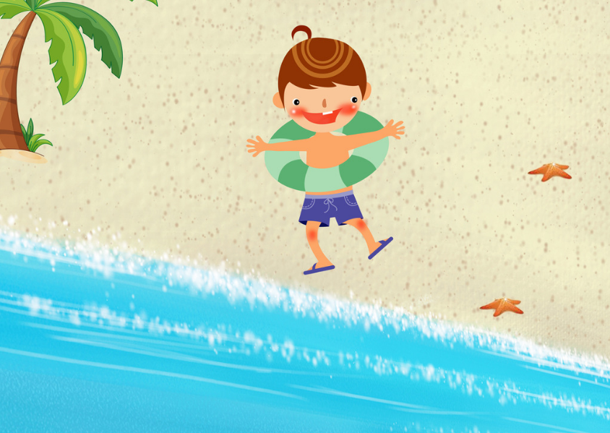
I like
funny

Slide 21
I like
funny

Slide 22
I like
funny

Slide 23
I like
funny

Slide 24

lovely

Slide 25
lovely

Slide 26
Let’s
get
started

Slide 27
Are you ready？

Slide 28
What are my hobbies?
-My hobbies are jogging ,painting and swimming.
I like jogging.
I am interested in painting.
I am crazy about swimming.

Slide 29
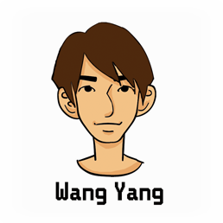


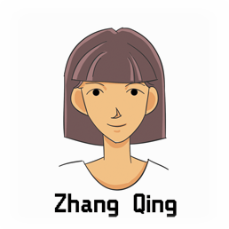
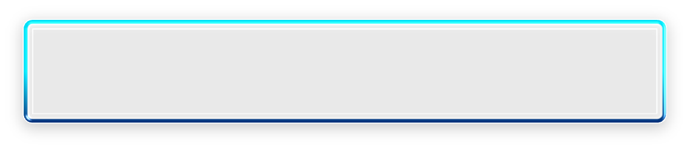
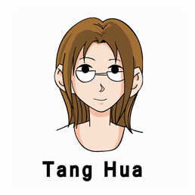

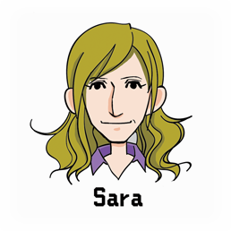
9.Read and complete.
Hello, I’m Wang Yang. I enjoy playing computer games a lot. I don’t like singing.
Hello, my name’s Zhang Qing. I love singing English songs. I hate playing the piano.
Hi, I’m Tang Hua. I’m a teacher. Playing chess is my favorite. I don’t enjoy football games.
Hi, I’m Sara. I’m from America. I think American football is very exciting. But I don’t like playing chess. It’s boring.

Slide 30



9.Read and complete.
_____________________________
_____________________________
playing computer games
singing
__________________________________
__________________________________
singing English songs
playing the piano
__________________________________
__________________________________
playing chess
football games
American football
__________________________________
__________________________________
playing chess

Slide 31

10. Read and match.
1）
She loves singing English songs, but she hates playing the piano.
4
2）
He likes playing computer games, but he doesn’t like singing.
3）
She enjoys playing chess, but she doesn’t like football games.
3
4）
She likes American football, but she doesn’t like playing chess.
4

Slide 32
11. Read and write.
Example:
Tom likes playing badminton , but he doesn’t like singing.
Anna likes going shopping , but she doesn’t like watching TV.

Slide 33
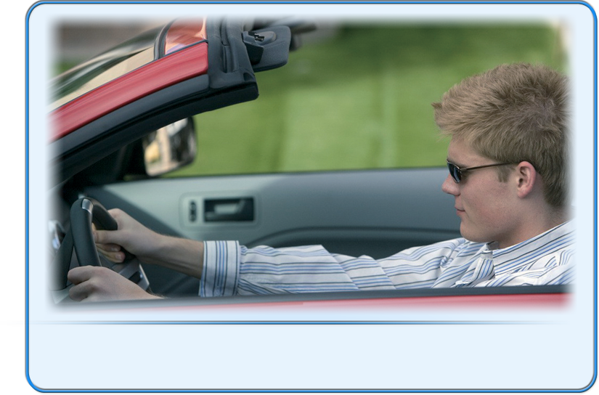

12.Look and complete.
likes
He __________ (like) driving.

Slide 34
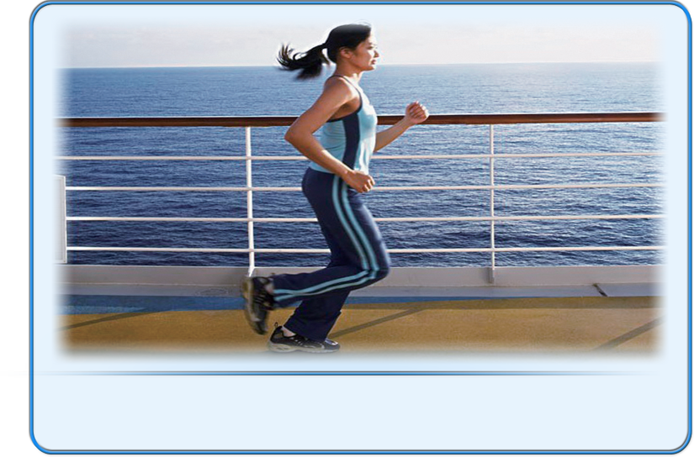

enjoys
She __________ (enjoy) jogging.

Slide 35
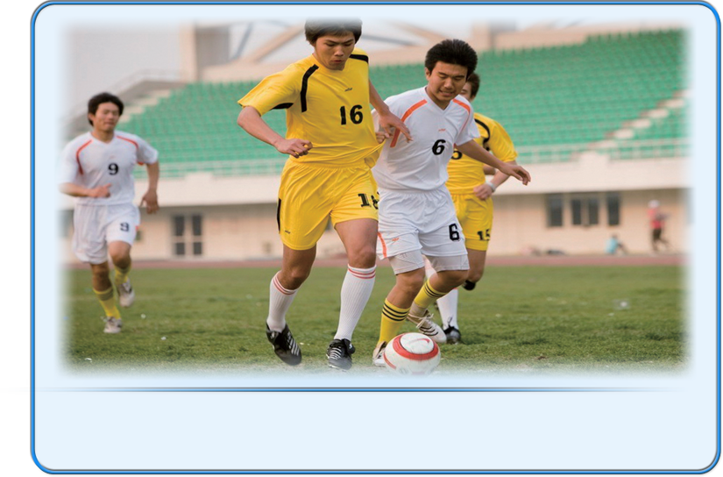

love
They __________ (love) playing football.

Slide 36
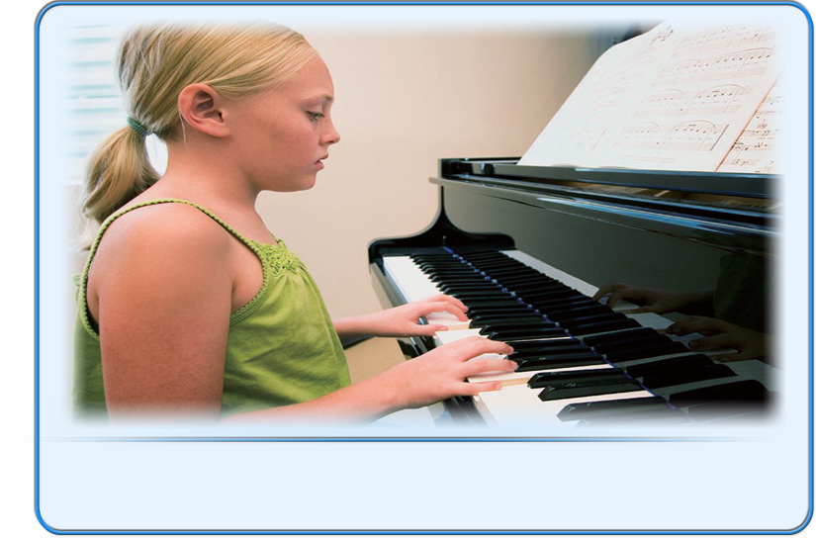

hates
She __________ (hate) playing the piano.

Slide 37


Look and complete.
Does
A: __________ he like flying kites?
B: No, he __________. He
__________ fishing.
doesn’t
enjoys/likes/loves

Slide 38
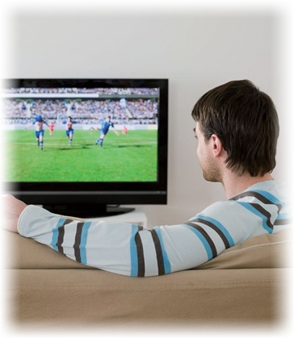

Do
A: __________ you like playing computer games?
B: No, I __________. I
__________ watching TV.
don’t
enjoy

Slide 39
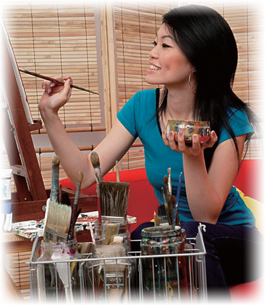

Does
A: _______ she like singing?
B: No, she __________.
A: What ________ she like?
B: She __________ painting.
doesn’t
does
likes

Slide 40
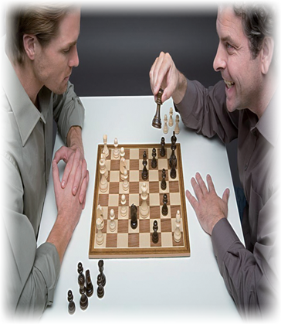

Do
A: __________ they enjoy shopping?
B: No, they __________.
A: What __________ they enjoy doing?
B: They __________ playing chess.
don’t
do
like

Slide 41
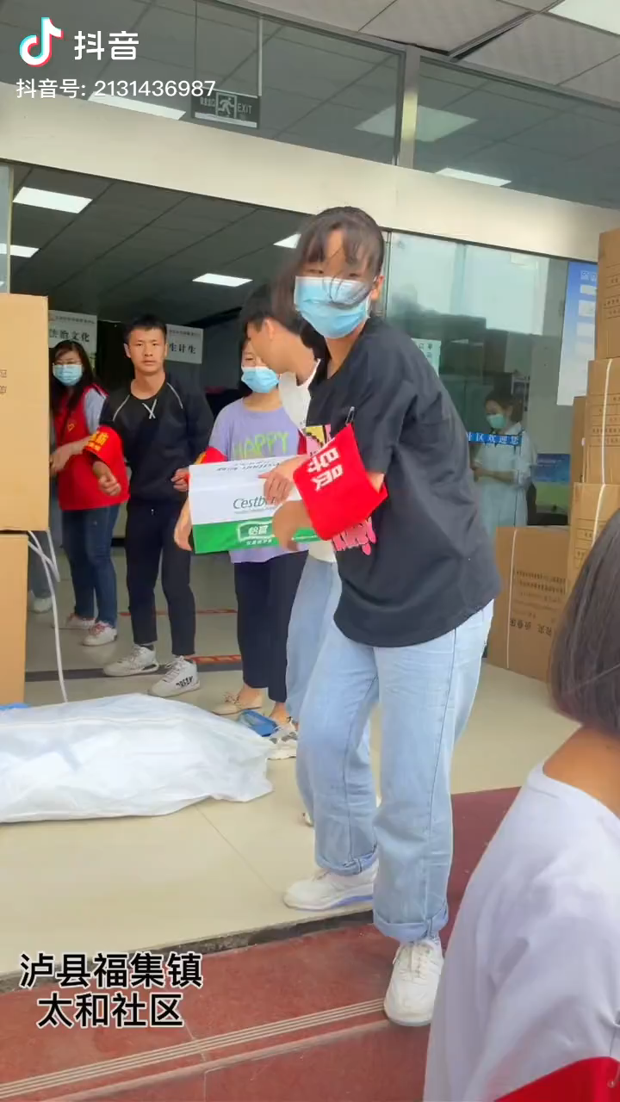

Slide 42
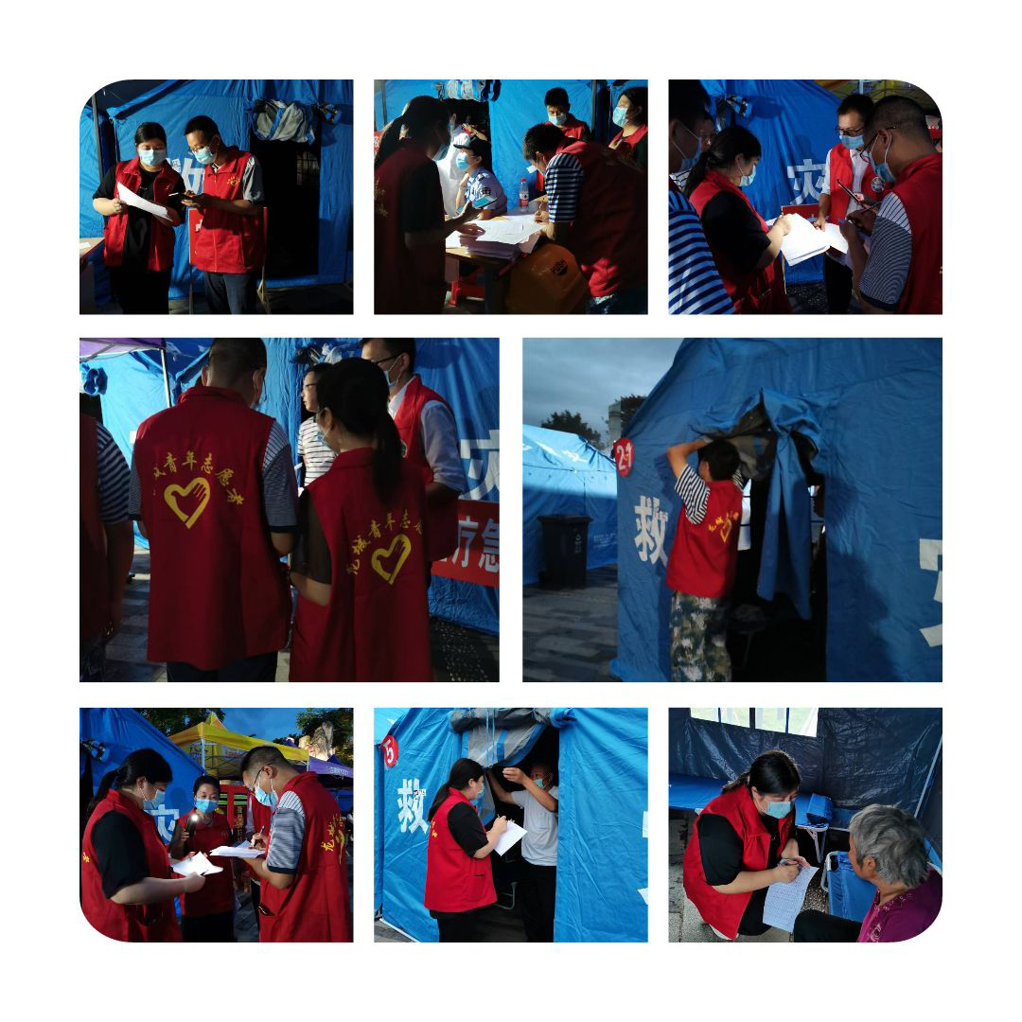
Develop ,infect others,benefit society.
positive hobbies

Slide 43
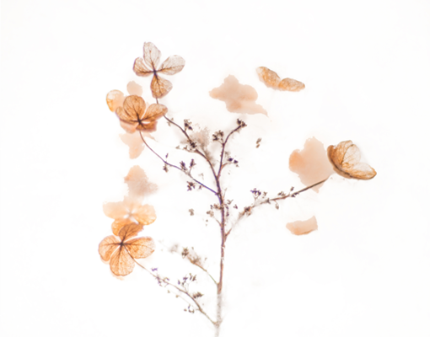
Summary
1) “How can we express our likes and dislikes?”
I like/love/enjoy......
I’m interested in/crazy about ......
I don’t like.....
I hate......
2)The sentence patterns of the third person:
What’s his/her hobby?
-He/She likes/enjoys/loves.....,but he/she doesn’t like/enjoy....../hate.....

Slide 44
Homework
1) Write a short passage about your own and your family.
2)Preview the rest of this unit.

Slide 45

No pains, no gains.
Fight for dream!

Slide 46
That’s all
Thank you

